Slide 1
Wrapper
Python code wrapper around voice separation model
Model has ConvTasNet architecture trained and implemented through the Asteroid API
The model the wrapper is based off of will be changed out to ours once developed
Wrapper:
Passes in audio with two speakers
Separates audio into two streams
Passes individual streams through noise reducer
Normalizes volume between all three voice clips

Slide 2
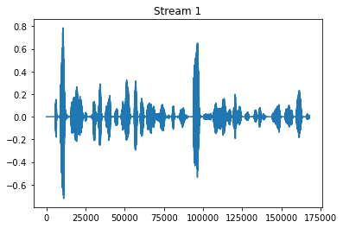

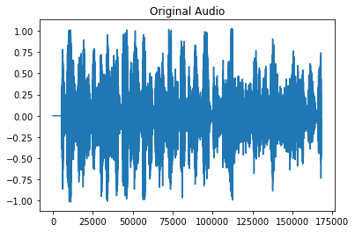
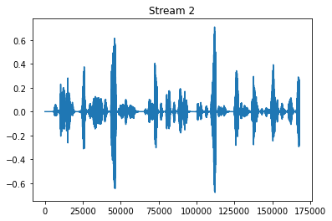
Wrapper Demo
Wrapper around Voice Separation Model

